Slide 1

Machine Learning for Cities
CUSP-GX 5003.001, Spring 2023
Lecture 7: Algorithmic Fairness, Discrimination, and Bias
Much of this material is re-used with permission from:
“Data-driven discrimination and fairness-aware classification” (M. Jankowiak)
“Bias and discrimination in data-driven decision making” (A. Chouldechova)
“Identifying significant predictive bias in classifiers” (Z. Zhang and D.B. Neill)

Slide 2
Outline of today’s lecture
The need for fairness in algorithms: motivation and examples.
Preventing disparate impact: a case study in criminal justice.
Group fairness: tweaking ML algorithms to prevent discrimination.
Calibration: Detecting and fixing systematic biases in risk prediction.

Slide 3
Why should we care about fairness?
Online algorithms can exacerbate demographic and socioeconomic disparities, e.g., through price discrimination or targeted advertising.
Sensitive decisions at the individual level: school admissions, job applications, loan/credit approval, insurance premiums…
Policing: geographic and demographic biases in targeted patrolling, “stop and frisk”, assumption of guilt/innocence, citation vs. warning…
Criminal justice: biases in sentencing and parole/probation decisions.
Provision of city services: resource disparities by neighborhood.
Many other quality of life factors: food deserts, poverty, environmental risk factors (e.g., pollution), access to fresh water…

Slide 4
http://www.wsj.com/articles/SB10001424127887323777204578189391813881534
What happened: lower store density in poor & ethnic minority neighborhoods → higher prices → racially disparate impact.

Slide 5
Unforeseen consequences!
http://www.wsj.com/articles/SB10001424127887323777204578189391813881534
What happened: lower store density in poor & ethnic minority neighborhoods → higher prices → racially disparate impact.
Reinforcing undesirable status quo!

Slide 6
http://arxiv.org/abs/1301.6822

Slide 7
How can we use machine learning to identify and reduce biases?
How can we avoid introducing new biases, or exacerbating existing biases, when we perform data-driven analyses?

Slide 8
Big data claims to be neutral. It isn’t.
Advocates of algorithmic techniques like data mining argue that
they eliminate human biases from the decision-making process. But an
algorithm is only as good as the data it works with. Data mining can inherit
the prejudices of prior decision-makers or reflect the widespread biases
that persist in society at large. Often, the “patterns” it discovers are simply
preexisting societal patterns of inequality and exclusion. Unthinking
reliance on data mining can deny members of vulnerable groups full
participation in society. Worse still, because the resulting discrimination is
almost always an unintentional emergent property of the algorithm’s use
rather than a conscious choice by its programmers, it can be unusually
hard to identify the source of the problem or to explain it to a court.
— “Big Data’s Disparate Impact,” Barocas & Selbst

Slide 9
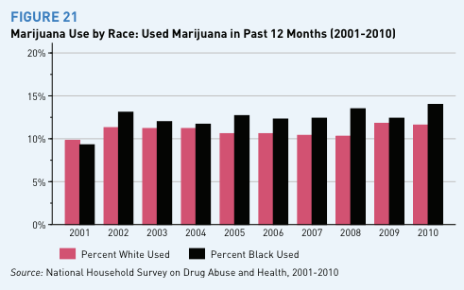
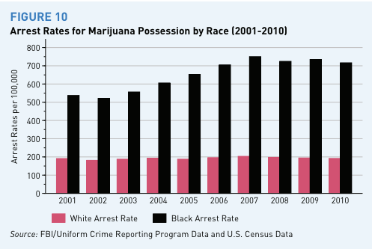
What’s your Y?
Y = candidate was hired vs. Y = employee productivity
Target variable bias: in recidivism prediction, we:
want Y = re-offense, have Y = re-arrest

Slide 10
Outline of today’s lecture
The need for fairness in algorithms: motivation and examples.
Preventing disparate impact: a case study in criminal justice.
Group fairness: tweaking ML algorithms to prevent discrimination.
Calibration: Detecting and fixing systematic biases in risk prediction.
Material re-used with permission from:
“Bias and discrimination in data-driven decision making” (A. Chouldechova)

Slide 11
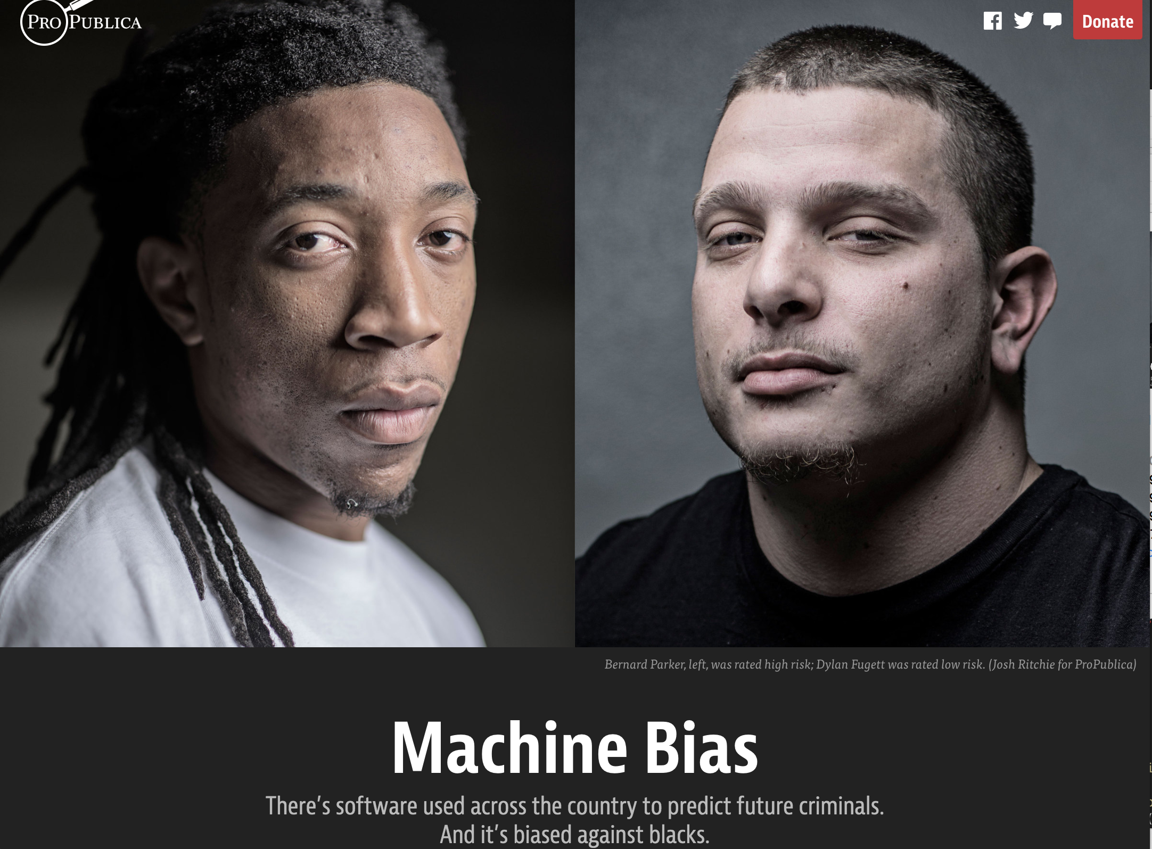
Source:
Julia Angwin,
Jeff Larson,
Surya Mattu and
Lauren Kirchner, ProPublica

Slide 12
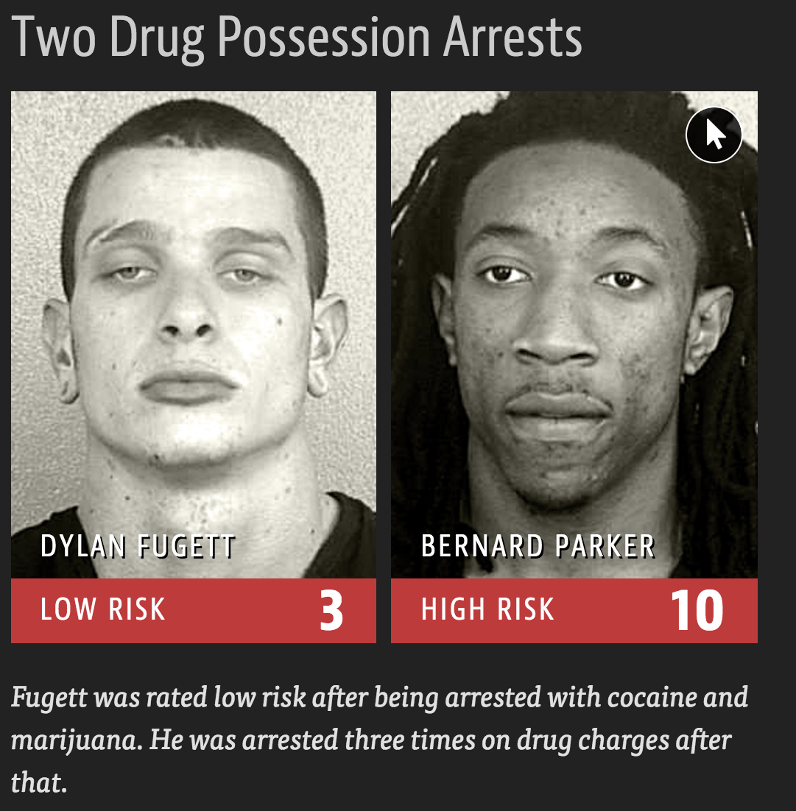
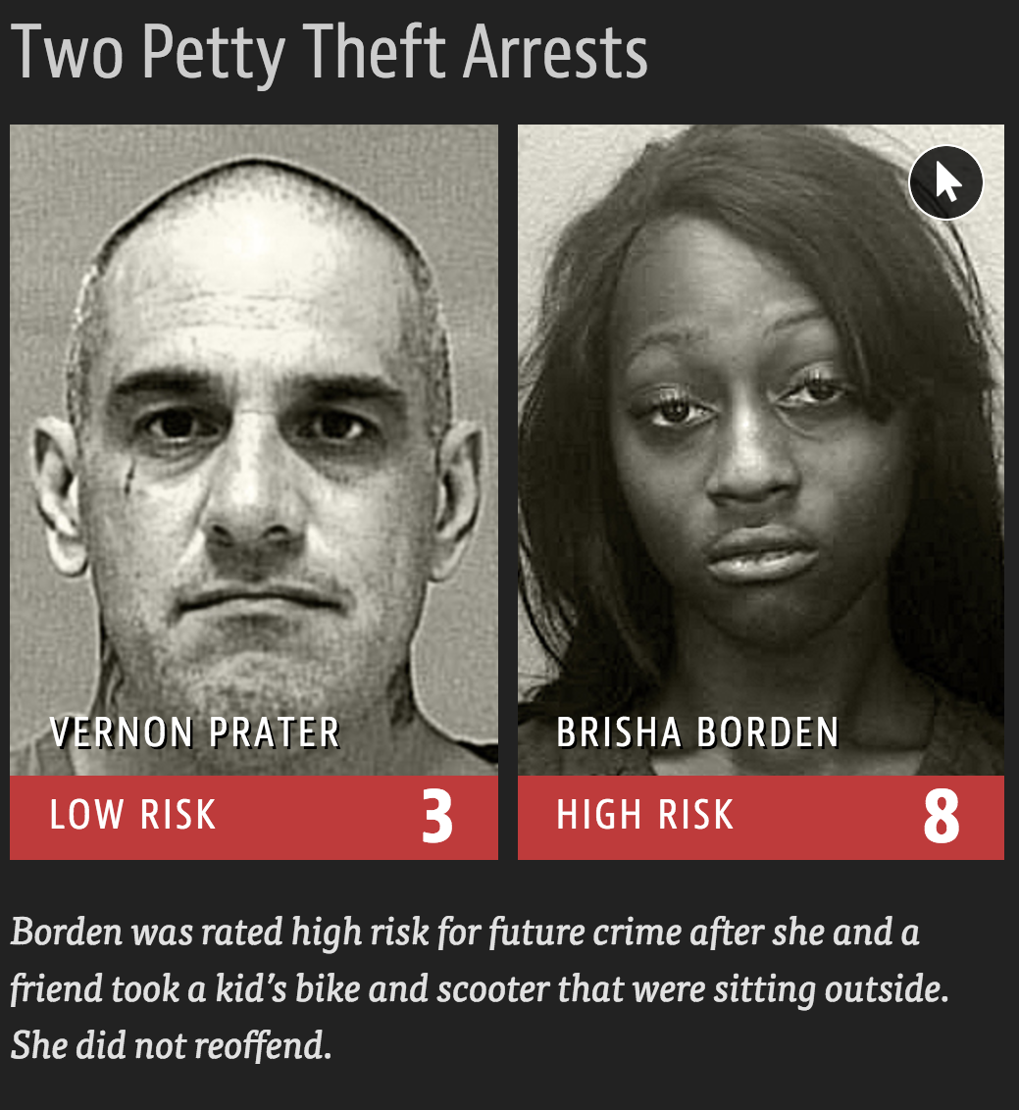
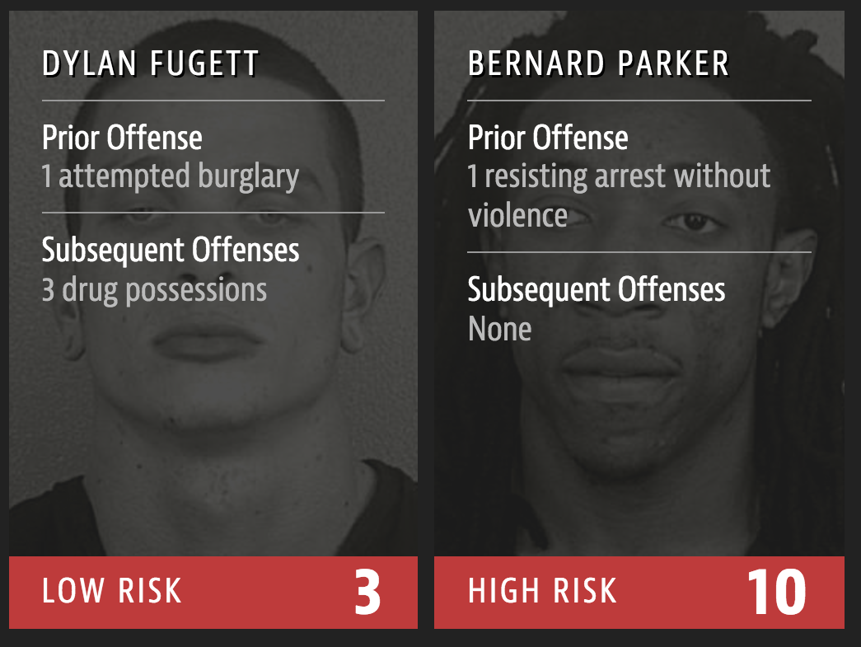
Source: ProPublica

Slide 13
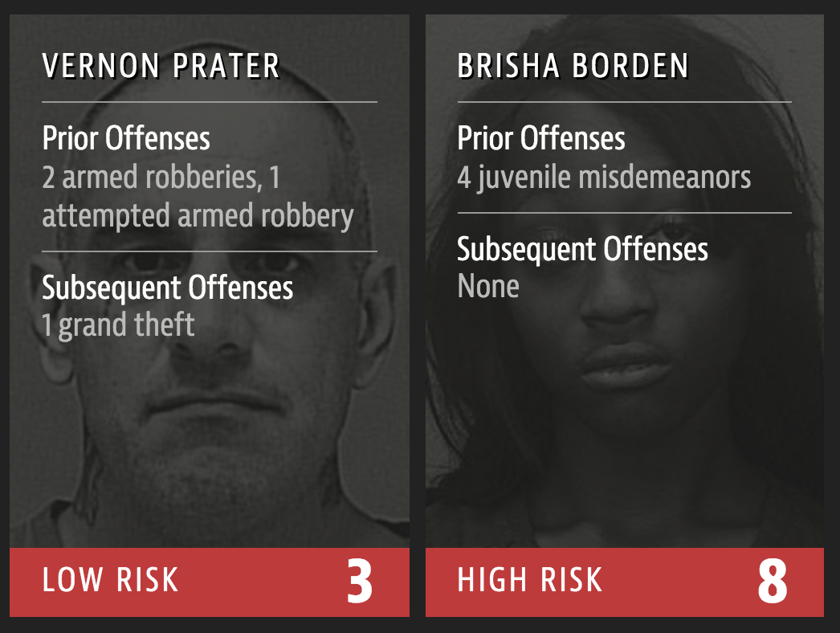
Source: ProPublica

Slide 14
Broward County data
Source: ProPublica’s data on criminal defendants in Broward County, Florida in 2013 – 2014, outcome assessed through April 2016
Score: COMPAS score, scale 1 – 10
<
>
>
>
>
>
Sample averages (standard deviations)

Slide 15
Black defendants receive higher scores, but are also younger and have worse criminal records.
Observed recidivism prevalence is higher among Black defendants.

Slide 16
Black defendants receive higher scores, but are also younger and have worse criminal records.
Is COMPAS fair?
Observed recidivism prevalence is higher among Black defendants.

Slide 17
Well, that depends on how you define fairness! There are at least three possibilities:
Group fairness: same proportions of each group should be classified as “high risk.” (?)
Calibration (unbiasedness): individual risk probabilities should be predicted as accurately as possible, without systematic upward or downward biases (based on race or other combinations of attributes).
Disparate impacts: equalize impacts by calibrating false positive and false negative rates in each group.
Black defendants receive higher scores, but are also younger and have worse criminal records.
Is COMPAS fair?
Observed recidivism prevalence is higher among Black defendants.

Slide 18
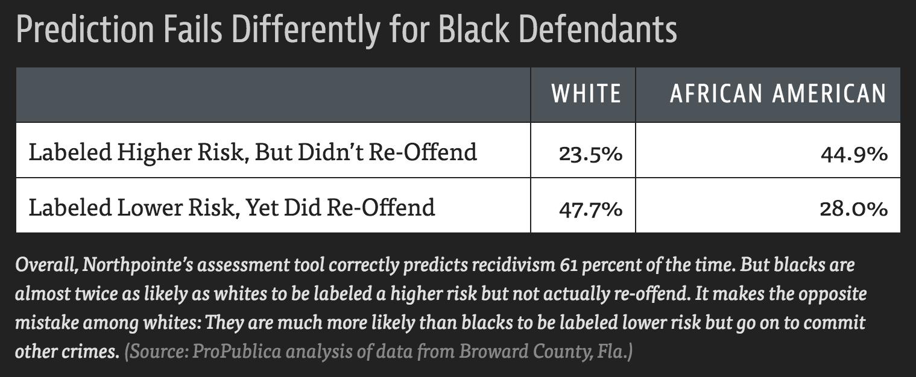

Slide 19
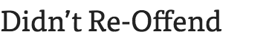
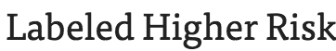
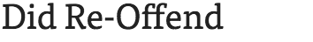
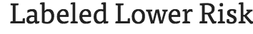
False positive rates
False negative rates
Positive predictive value (aka Precision)

Slide 20
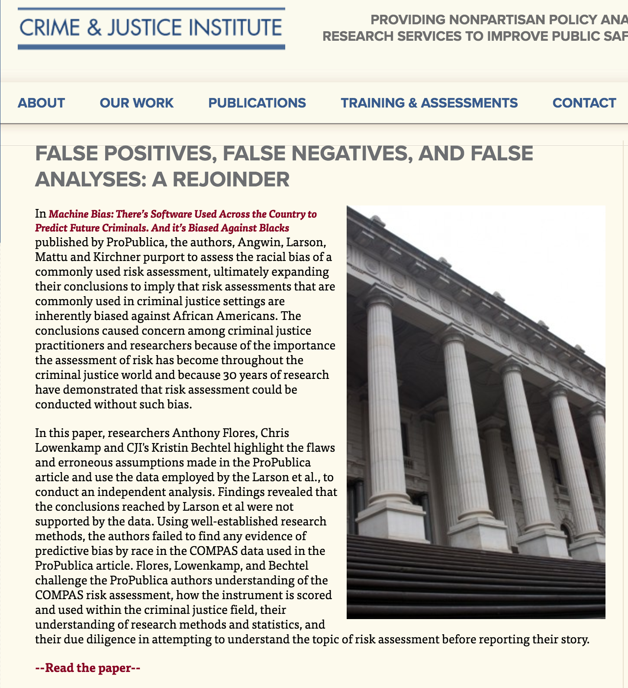
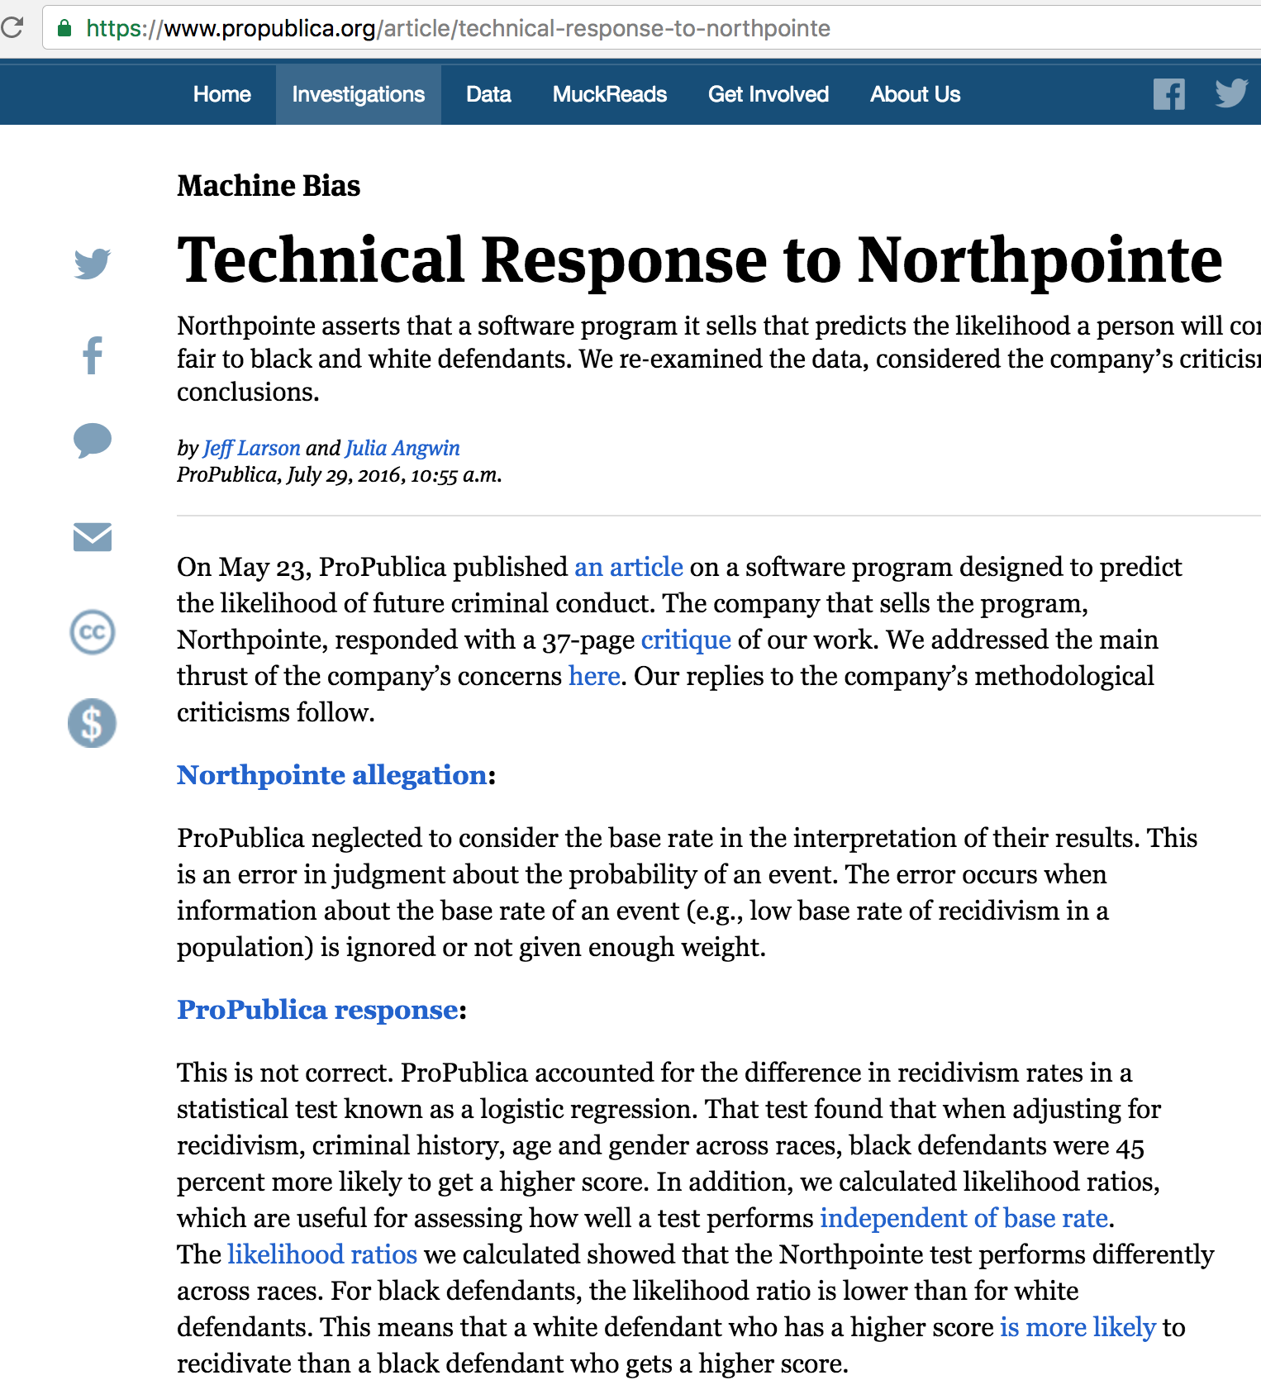
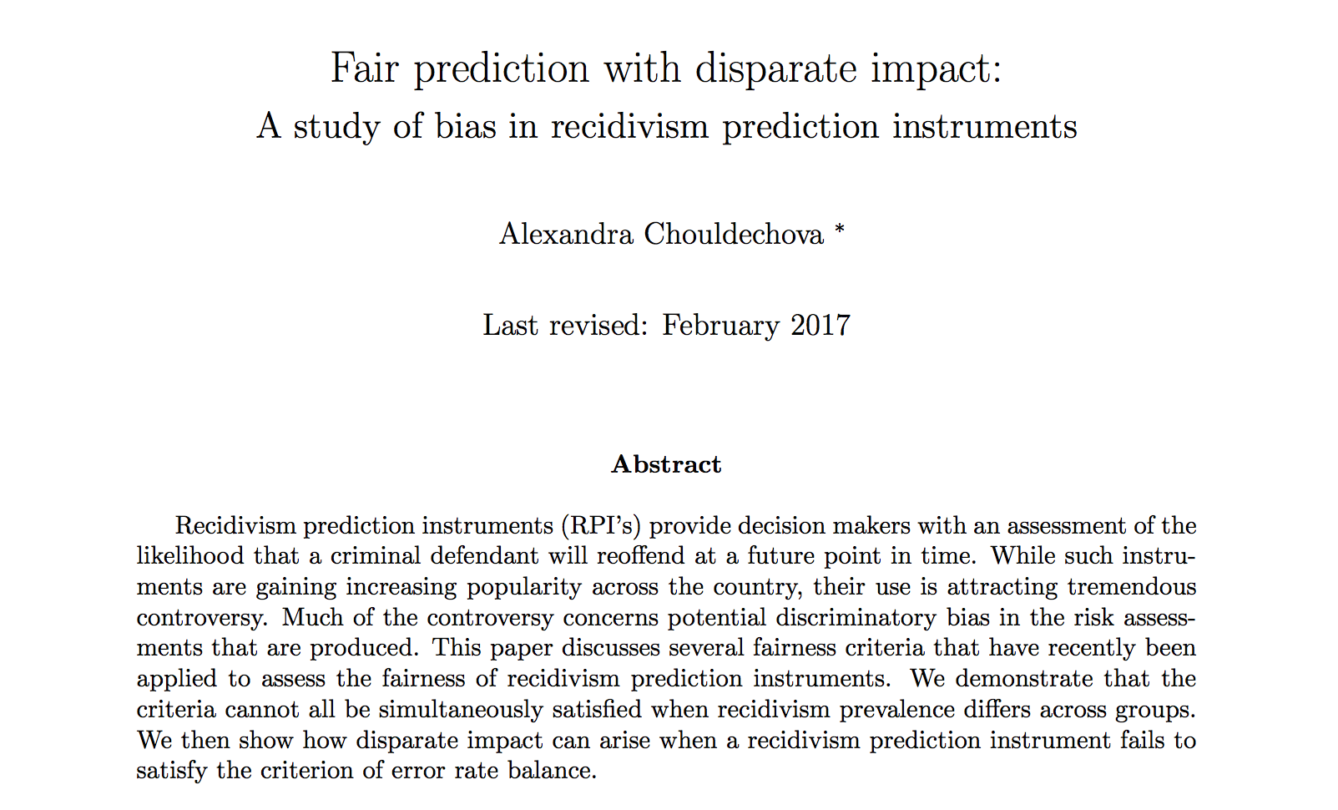


Slide 21
The debate in a nutshell
ProPublica
COMPAS is biased
Northpointe
COMPAS is fair
COMPAS has a 1.9x higher FPR and 1.7x lower FNR among Black defendants
COMPAS satisfies
predictive parity*
(*has equal PPV across groups)
Among defendants classified as High Risk, 63% of Black defendants and 59% of White defendants are observed to reoffend.
i.e., COMPAS is “equally predictive of recidivism” for Black and White defendants.
It turns out:
When recidivism prevalence differs across groups: predictive parity error rate imbalance
Error rate imbalance leads to disparate impact under policies that assign stricter penalties to individuals assessed as higher-risk.

Slide 22
Fairness metrics
Score S. If S > s_{HR} , say the person is “High Risk”
Outcome
Group membership, e.g., Race
Question
What does it mean for S to be fair with respect to R?
Typical approach
Compare various accuracy and error metrics across groups.

Slide 23
Building blocks: Confusion tables
Score S. If S > s_{HR} , say the person is “High Risk”
Outcome
Group membership, e.g., Race

Slide 24
Predictive parity (Northpointe’s criterion)
reoffend
classified HR
reoffend
classified HR
If COMPAS satisfies predictive parity, we would expect to see:
For each score cutoff s_{HR}, observed recidivism rates are approximately the same among Black and White defendants whose score exceeds the threshold.
i.e., the PPV at score cutoff s_{HR} is the same among Black and White defendants
COMPAS looks to satisfy predictive parity with respect to the defendant’s race at least for cutoffs 4-9.

Slide 25
False positive rate balance (ProPublica criterion)
classified HR
do not reoffend
classified HR
do not reoffend
COMPAS looks to have higher false positive rates for Black defendants.
This is bad for Black defendants.

Slide 26
False negative rate balance (ProPublica criterion)
classified LR
reoffend
classified LR
reoffend
COMPAS looks to have lower false negative rates for Black defendants.
This is bad for Black defendants.

Slide 27
Looking back at the high-risk cutoff of s_{HR} = 4
predictive parity
false positive rate imbalance
false negative rate imbalance

Slide 28
Can we fix it?
YES WE CAN!
T
NO

Slide 30
Predictive parity implies Error rate imbalance
Predictive parity criterion requires: The Positive Predictive Value (PPV) of S should be the same for all values of R.
Key relationship:
prevalence
error rates
Takeaway
Chouldechova 2016, Kleinberg et al. 2016
When the prevalence differs across groups, requiring that the PPV’s be equal implies that the FNR and FPR cannot both be equal across those groups.
(Except in edge cases such as when PPV = 1)

Slide 31
Sentencing guidelines
Guidelines provide a range of possible sentences [t_{min}, t_{max}] based on a convicted offender’s current crime and criminal history.
Broward County data is insufficient to calculate prior record scores for our cohort, so we’ll assume a prior score of 1 for the empirical analysis.

Slide 32
We’ll consider two risk-based sentencing policies:
MinMax
Interpolation

Slide 33
Recidivists would receive longer sentences than non-recidivists
Black defendants would receive significantly longer sentences compared to White defendants.
Among non-recidivists, this is due to the higher FPR among Black defendants.
Among recidivists, this is due to the higher FNR among White defendants.
Under non-discriminatory policies that do not take risk into account, we would expect all 4 lines to be exactly the same.
* Except at OGS level 8, observed differences in average sentences between Black and White defendants in both the recidivating and non-recidivating groups are statistically significant at the 0.01 level.

Slide 34
Can we mitigate disparate impact?
Yes. Two possible approaches:
Re-build scoring model to maximize accuracy subject to error rate balance constraints (see e.g., Zafar et al. (2016))
Rebalance FNR and FPR by using different score thresholds across groups (see e.g., Hardt, Price, Srebro (2016))
Let's try approach (b):
Use a COMPAS score cutoff of 6 for Black defendants, while keeping a cutoff of 4 for White defendants.

Slide 35
Allowing group-specific cutoffs
Before:
Cutoff = 4 for both groups
imbalanced!
After:
Cutoff = 6 for Black def.’s
Cutoff = 4 for White def.
balanced!

Slide 36
Did we succeed?
MinMax Sentencing, Before
MinMax Sentencing, After cutoff change
Inequity in sentencing among recidivists
Equity in sentencing among non-recidivists
Takeaway
Balancing overall error rates is insufficient. Balance must be achieved at sufficiently fine levels of granularity.

Slide 37
Outline of today’s lecture
The need for fairness in algorithms: motivation and examples.
Preventing disparate impact: a case study in criminal justice.
Group fairness: tweaking ML algorithms to prevent discrimination.
Calibration: Detecting and fixing systematic biases in risk prediction.
Material re-used with permission from:
“Data-driven discrimination and fairness-aware classification” (M. Jankowiak)

Slide 38
Statistical Parity or “group fairness”: an entirely different notion of fairness
hired
man
hired
woman
Reasonable fairness criterion in settings such as employment
Not reasonable in risk assessment
Lots of recent work on constructing models that satisfy statistical parity
Caution:
Statistical parity shouldn’t be an end in itself
E.g., Could just hire top 10% of men and a random 10% of women
Self-fulfilling prophecy of discrimination (Dwork et. al. )

Slide 39
Discrimination
“Discrimination refers to an unjustified distinction of individuals based on their membership, or perceived membership, in a certain group or category. Justified distinctions are exceptions explicitly admitted by law, such as imposing a minimum age for voting in elections, or that are proven (sometimes in court) as being objective and legitimate, such as requiring a man for a male character in a film. Some groups, traditionally subject to discrimination, are explicitly listed as ‘protected groups’ by national and international human rights laws.”
from “A multidisciplinary survey on discrimination analysis”

Slide 40
How algorithms can discriminate
Problem specification (definition of target variable, features, etc.)
e.g. electing to hire on the basis of predicted tenure can be more likely to have a disparate impact on certain protected classes than hiring decisions that turn on some estimate of worker productivity

Slide 41
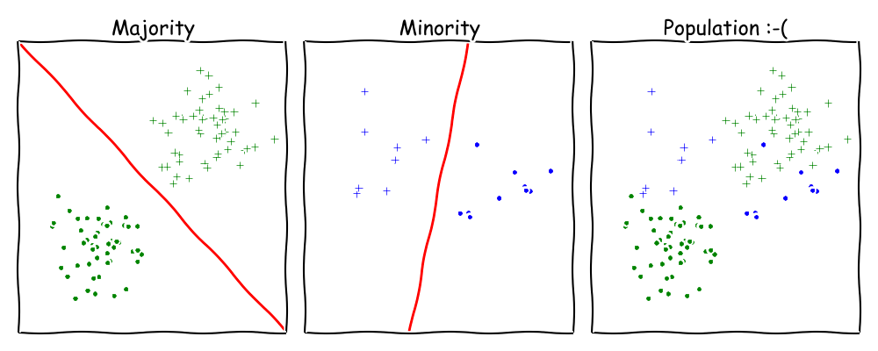
How algorithms can discriminate
Problems with training data:
— the data generating process itself was inherently discriminatory
— biased/imbalanced data samples
Notes:
streetbump, an app for boston residents that uses smart phone accelerometers to detect potholes
Example: St. George’s Hospital (UK) sorted med school applicants on the basis of previous admission decisions [biased against women and minorities with equal credentials]
incomplete/missing data may be correlated with the sensitive attribute

Slide 42
How algorithms can discriminate
via proxies
“when the criteria that are genuinely relevant in making rational and well-informed decisions also happen to serve as reliable proxies for class membership. In other words, the very same criteria that correctly sort individuals according to their predicted likelihood of excelling at a job may also sort individuals according to class membership”
Notes:
Take, for example, the fact, discovered by Evolv, a “workforce optimization” consultancy, that “distance between home and work . . . is strongly associated with employee engagement and retention.” Despite the strength of this finding, Evolv “never factor[s it] into the score given each applicant . . . because different neighborhoods and towns can have different racial profiles, which means that scoring distance from work could violate equal-employment opportunity standards.

Slide 43
How algorithms can discriminate
via proxies
hidden attribute
from “Why Unbiased Computational Processes Can Lead to Discriminative Decision Procedures,” Calders & Žliobaitė
Notes:
An important side effect of this treatment, however, will be that a calm male driver will actually receive a higher insurance premium than an aggressive female driving the same car and being of the same age.

Slide 44
Simple fixes that don’t work
removing the sensitive attribute
from “Why Unbiased Computational Processes Can Lead to Discriminative Decision Procedures,” Calders & Žliobaitė
Notes:
The next step would be to remove the correlated attributes as well. This seems straightforward in our example dataset; however, it is problematic if the attribute to be removed also carries some objective information about the label. Suppose a postal code is related to ethnicity, but also carries information about real estate prices in the neighborhood.

Slide 45
Simple fixes that don’t work
Building separate models for each value of the
sensitive attribute
from “Why Unbiased Computational Processes Can Lead to Discriminative Decision Procedures,” Calders & Žliobaitė
Notes:
Unfortunately, this does not solve the problem either if the historical decisions are discriminatory.

Slide 46
Adverse affect and
the 80% rule
from Biddle
Notes:
US govt first mentioned adverse impact in the Equal Employment Opportunity Commission Guidelines on Employment Testing Procedures (1966)
State of California Fair Employment Practice Commission
the Supreme Court has resisted a “rigid mathematical formula” defining disparate impact

Slide 47
Adverse affect and
the 80% rule
from “Certifying and removing disparate impact”,
Notes:
aka relative chance aka selection rate
what about 3 classes?

Slide 48
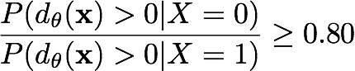
Adverse affect and
the 80% rule
consider a classifier defined by a decision boundary;
to satisfy the 80% rule our classifier must satisfy
unfortunately this isn’t a very well-behaved objective function
(as a function of the parameters theta)

Slide 49
One quantitative learning
approach to fairness:
decision boundary covariance
decision boundary
sensitive
class
“Learning Fair Classifiers.” Muhammad Bilal Zafar, Isabel Valera, Manuel Gomez-Rodriguez, Krishna P. Gummadi
http://arxiv.org/pdf/1507.05259v3.pdf

Slide 50
Decision boundary covariance
this will serve as our measure of unfairness
making this small does NOT guarantee that the 80% rule will be satisfied; but as we will see, in practice a small value of the covariance will typically lead to a balanced ratio of

Slide 51
Maximizing accuracy under fairness constraints
our constrained optimization problem
with fairness constraints:
logistic regression case

Slide 52
Maximizing accuracy under fairness constraints
linear SVM case

Slide 53
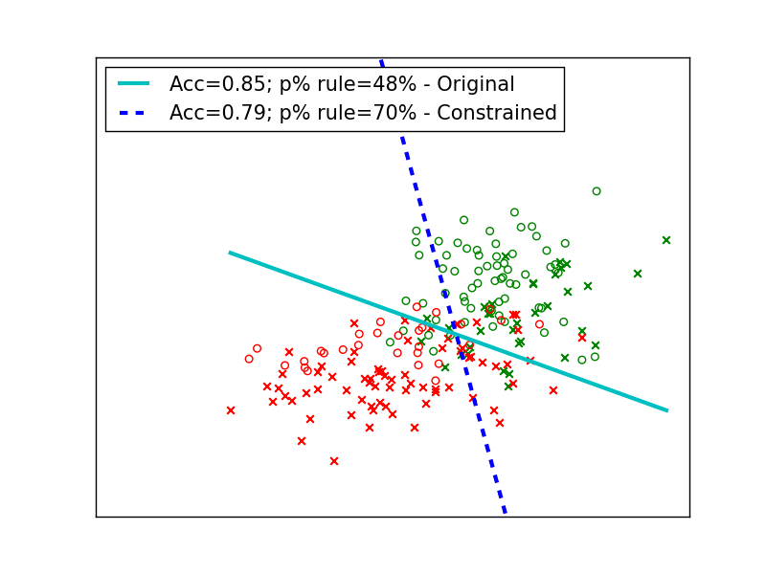
Maximizing accuracy under fairness constraints
https://github.com/mbilalzafar/fair-classification

Slide 54
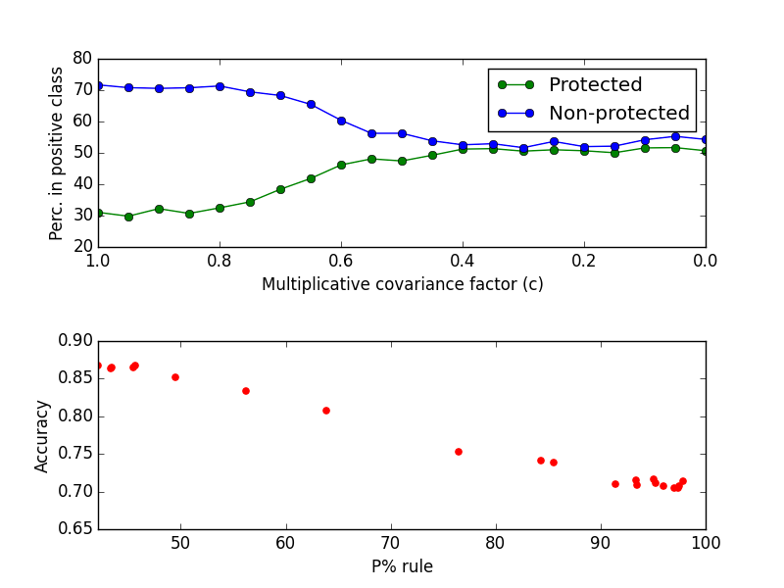
Maximizing accuracy under fairness constraints

Slide 55
Outline of today’s lecture
The need for fairness in algorithms: motivation and examples.
Preventing disparate impact: a case study in criminal justice.
Group fairness: tweaking ML algorithms to prevent discrimination.
Calibration: Detecting and fixing systematic biases in risk prediction.

Slide 56
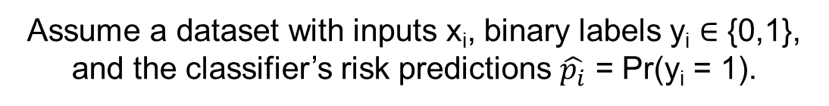
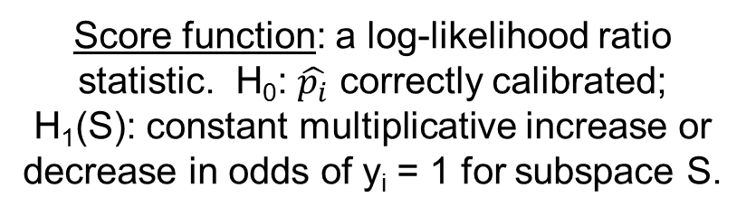
Another perspective (mine…)
Whether our goal is to achieve group fairness or reduce disparate impacts, our first step should be to predict risk as accurately as possible.
In particular, we wish to detect and correct any systematic biases in risk prediction that a classifier may have (i.e., over-predicting or under-predicting risk for a specific attribute or combination of attributes).
Thus we developed a new subset scan method to identify subgroups where classifier predictions are significantly biased (Zhang & Neill, 2016).
Assume a dataset with inputs x_{i}, binary labels y_{i} ∈ {0,1}, and the classifier’s risk predictions $\hat{p_{i}}$ = Pr(y_{i} = 1).
Search space: subspaces defined by a subset of values for each attribute (e.g., “white and Asian males under 25”)
Score function: a log-likelihood ratio statistic. H₀: $\hat{p_{i}}$ correctly calibrated;
H₁(S): constant multiplicative increase or decrease in odds of y_{i} = 1 for subspace S.

Slide 57
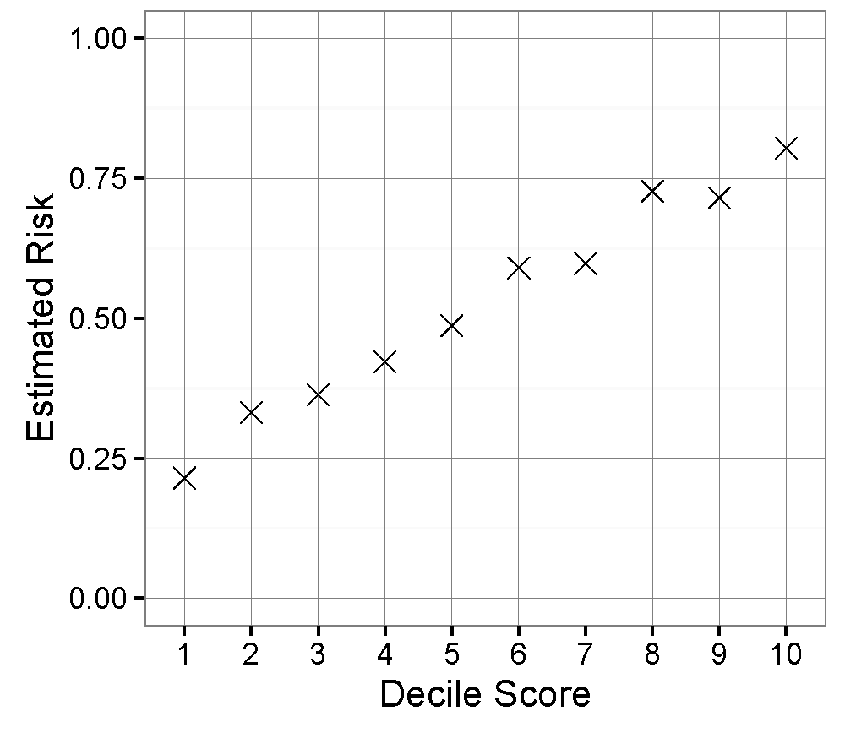
Results of bias scan on COMPAS
Start with maximum likelihood risk estimates for each COMPAS decile score.
Detection result 1: COMPAS underestimates the importance of prior offenses, overestimating risk for 0 priors, and underestimating risk for 5 or more priors.
Detection result 2: Even controlling for prior offenses, COMPAS still underestimates risk for males under 25, and overestimates risk for females who committed misdemeanors.

Slide 58
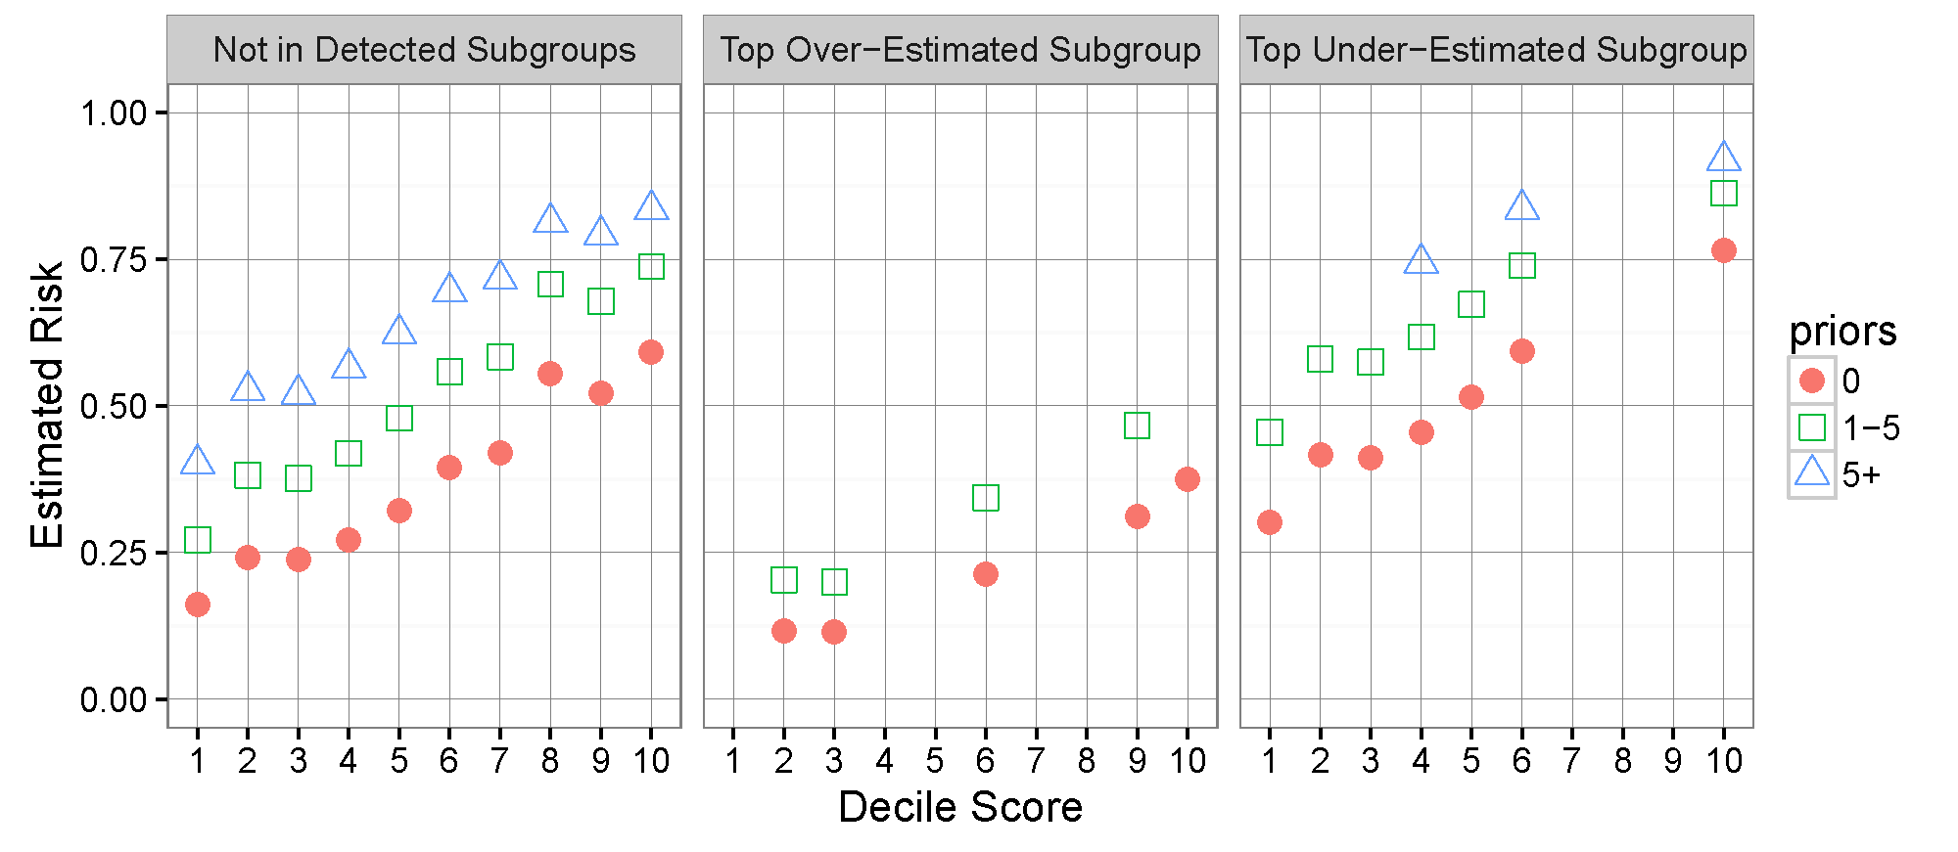
Results of bias scan on COMPAS
After controlling for prior offenses and membership in the two detected subgroups, there are no significant systematic biases in prediction.
Thorny question: given individual risk predictions, what to do with them?

Slide 59
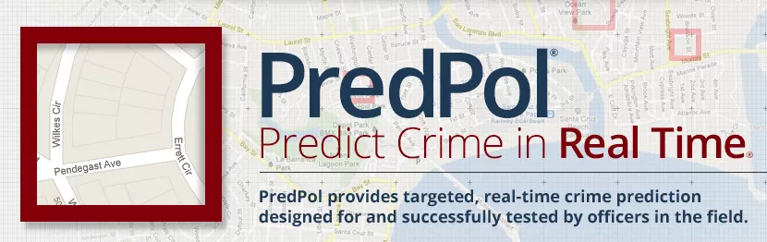
The bigger picture

Slide 60
Should we adopt data-driven approaches?
Perfect prediction
fairness-aware
data-driven approaches
Fairness
Current practice
Accuracy

Slide 61
References
Resources for fairness, accountability, and transparency in ML: https://www.fatml.org/resources/relevant-scholarship
A. Chouldechova. Fair prediction with disparate impact: a study of bias in recidivism prediction instruments. Big Data, 5(2): 153-163, 2017.
Z. Zhang and D.B. Neill. Identifying significant predictive bias in classifiers. https://arxiv.org/pdf/1611.08292.pdf. In NIPS Workshop on Interpretable Machine Learning, 2016.
A Romei & S Ruggieri. A multidisciplinary survey on discrimination analysis. http://www.di.unipi.it/~ruggieri/Papers/ker.pdf
S. Barocas and A.D. Selbst. Big Data’s Disparate Impact. In 104 California Law Review 671, 2016.
Žliobaitė, I. Measuring discrimination in algorithmic decision making. Data Mining and Knowledge Discovery, 31(4): 1060-1089, 2017. http://www.zliobaite.com/publications
M. Bilal Zafar, et al. Learning Fair Classifiers. Tech. report, 2016. http://arxiv.org/pdf/1507.05259v3.pdf
S. Feldman et al.. Certifying and removing disparate impact. In Proc. KDD 2015, http://sorelle.friedler.net/papers/kdd_disparate_impact.pdf

